Slide 1
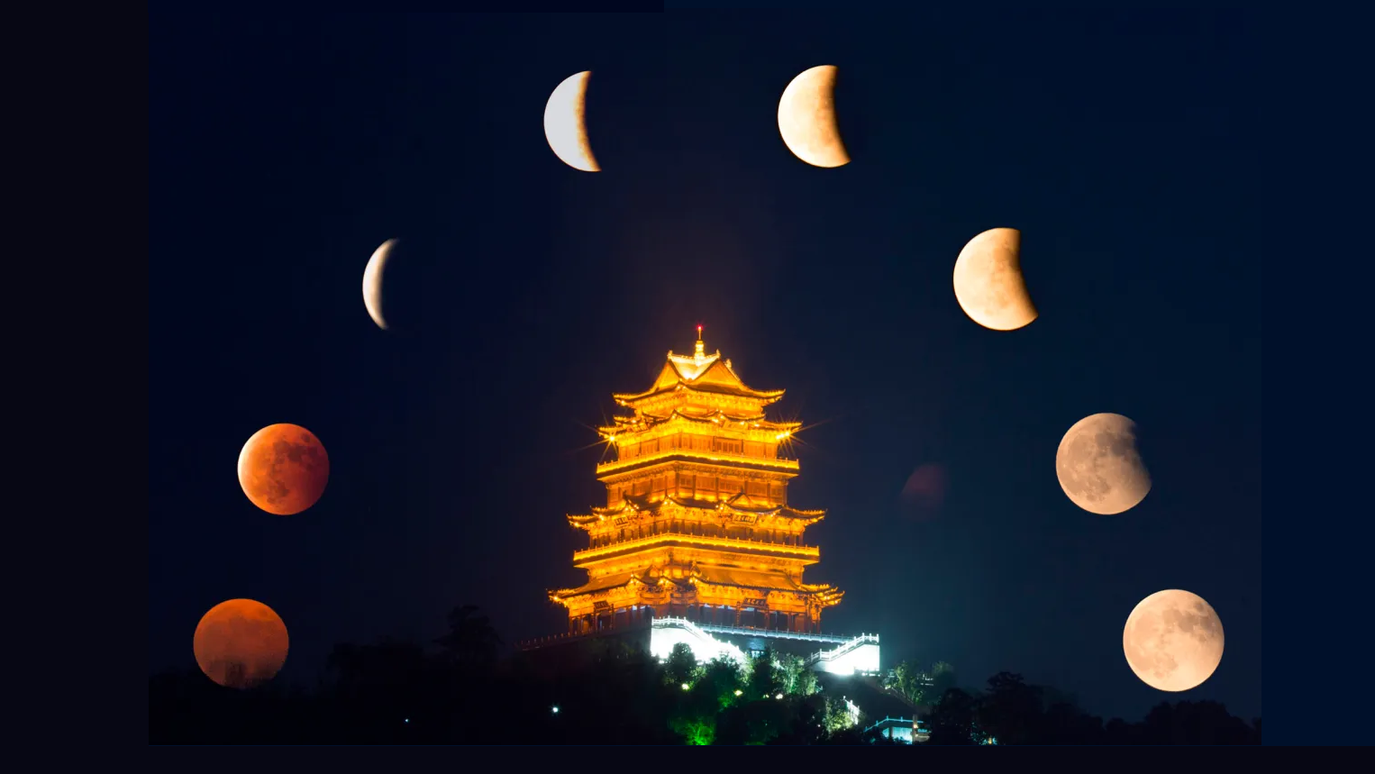
中国月亮 zhōngguó yuè liàng
By Selogi Sloey

Slide 2
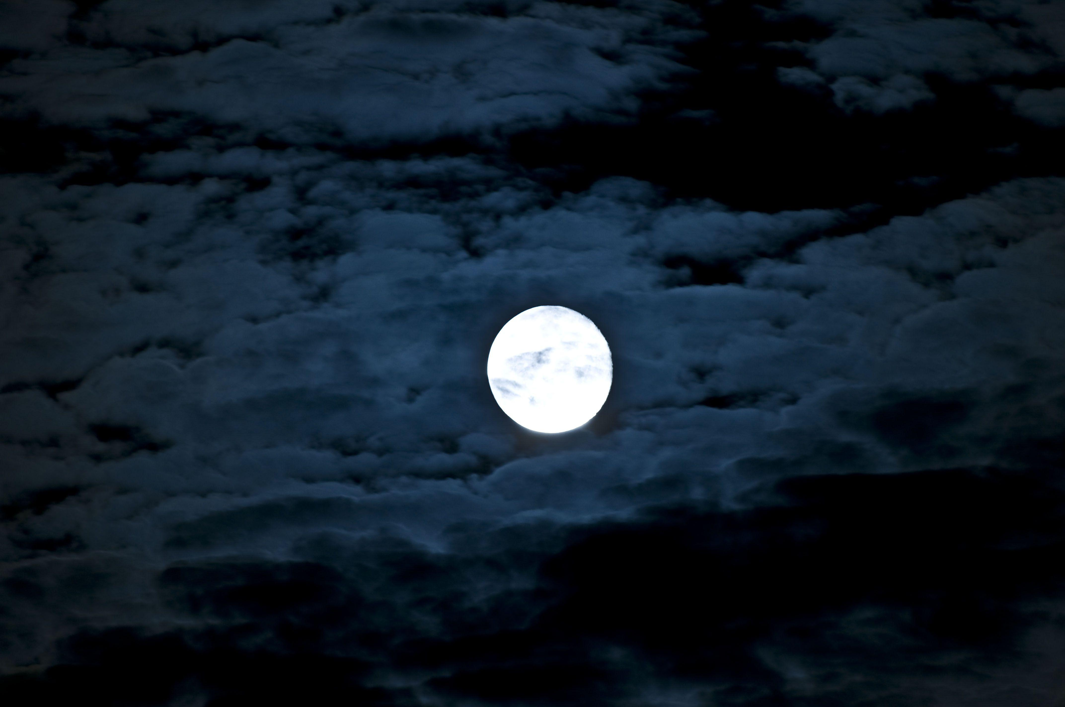
CHARACTER FOR MOON
月
Yuè

Slide 3
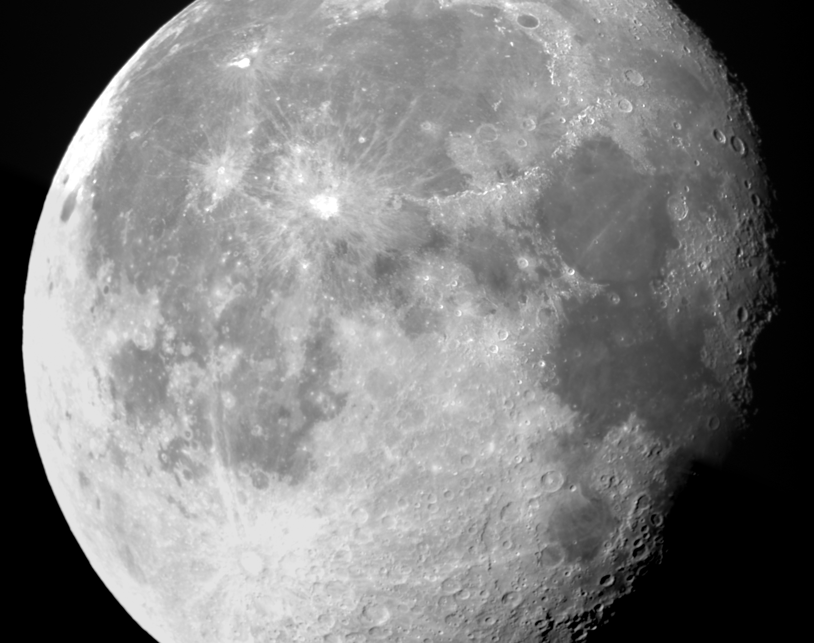
The Moon in Modern Chinese Culture
Represents harmony and balance
In some areas, also love.
Intrinsically connected to Yin and Yang, Yin = feminine.
In this case Sun and Moon
Many modern ideas originate from over 2,000 years ago.
The Moon also symbolizes connections, even across large distances.
So significant it’s the base of the Chinese calendar system.

Slide 4
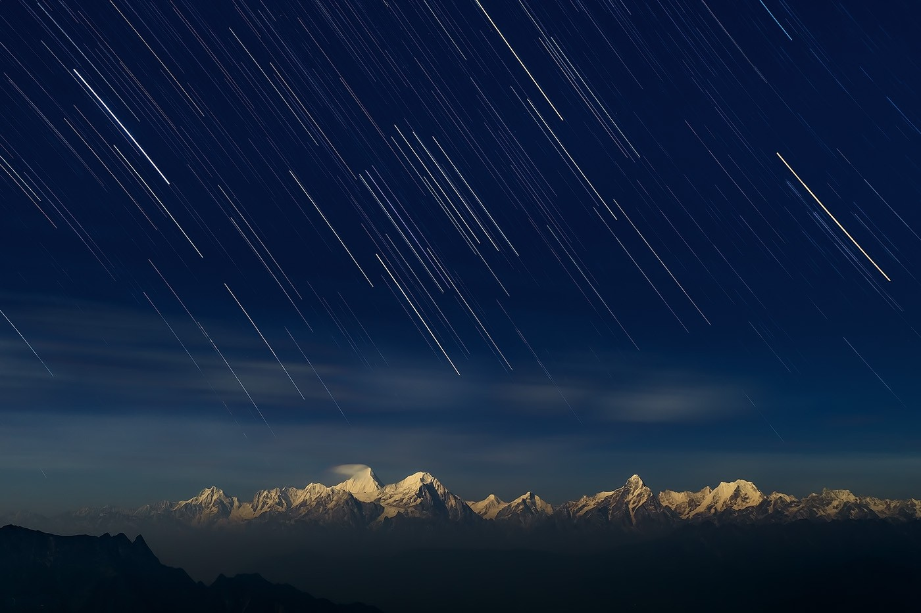
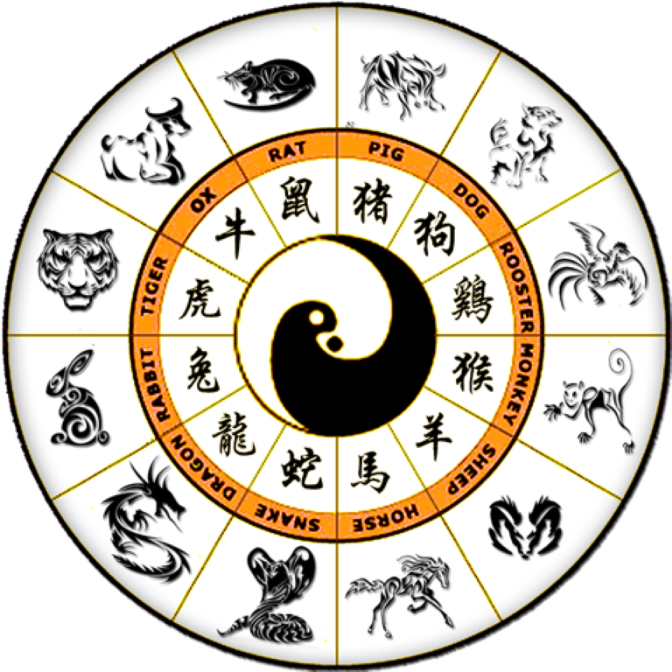
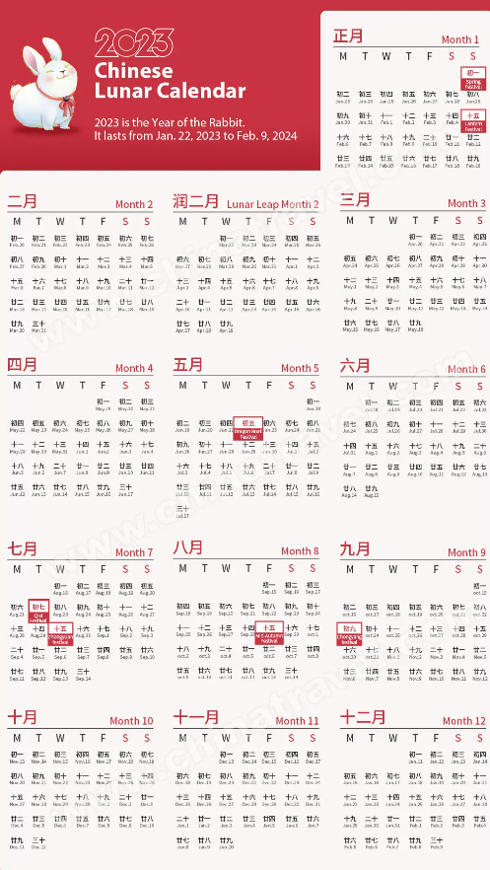
Lunar Calendar
During the founding of what would become Chinese culture, ancient astronomers took a keen interest in mapping the moon and its cycles.
Takes place over 12 lunar cycles; 354 days
Steeped in legend and folk tales.
农历
nóng lì
Currently in the year 4721
Currently in the year of the Rabbit, next year is the year of the Dragon

Slide 5
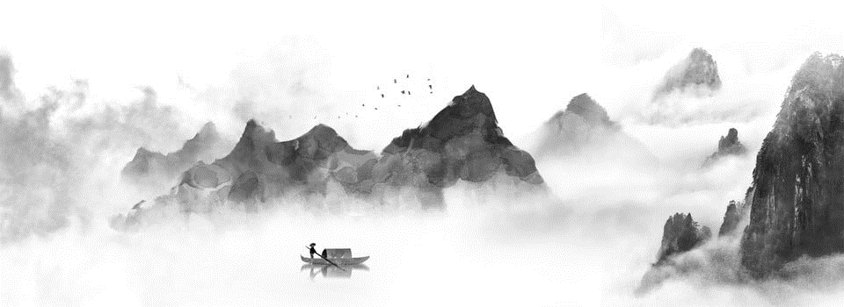
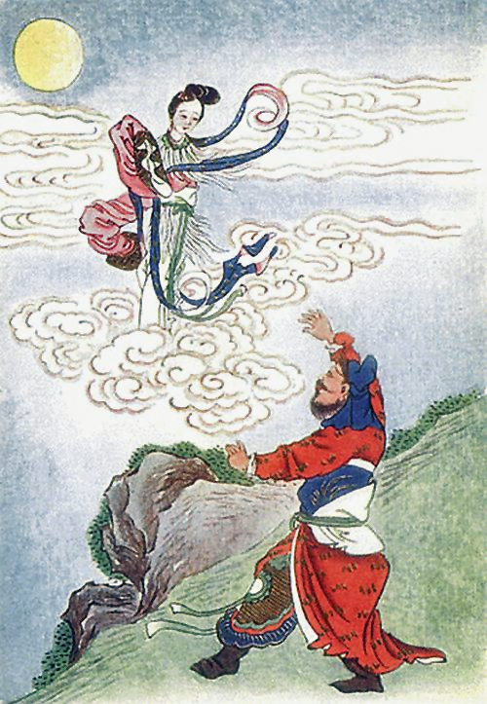
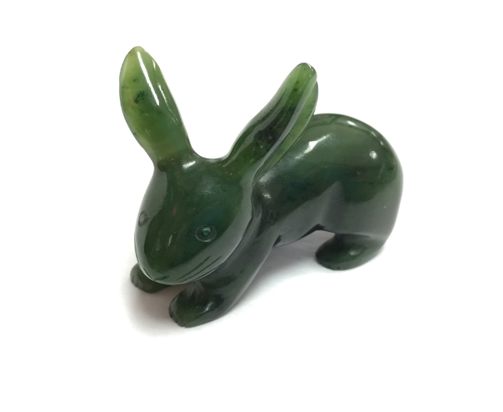
The Moon in Chinese Mythology
月兔
嫦娥
Yuètù, The Jade Rabbit
The Jade Emperor, the head of all mythology, disguised himself as an old man starving man. He came across a rabbit and asked for food, which the rabbit jumped into a fire to offer himself.
Moved by the gesture, the Jade Emperor made the rabbit immortal and made of jade. The rabbit was sent to the moon, where he now makes an immortality elixir from a mortar and pestle.
This legend has no timeframe, very distant past.
The Legend of Chang E
One day, 10 suns rose above the earth, scorching the planet. An archer named Hue Yi shot down 9 suns, keeping only 1. He was rewarded with the Elixir of Immortality by the gods. He reluctantly took it.
Later, his apprentice broke into his house while Yi was out hunting. He assaulted his wife, Cheng E to get the bottle. In the fight, Cheng E drank it. She became ethereal and flew up to the moon. Since then, Hue Yi would present her favorite fruits and cakes once per year, and that’s how the Chinese Mid-Autumn Festival came to be.
This legend has been said to take place around 2170 BCE.

Slide 6
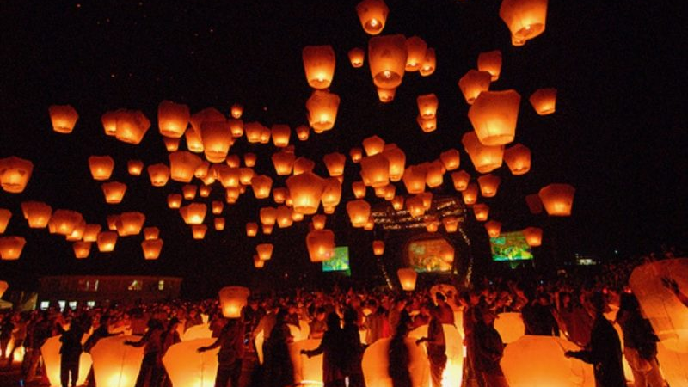
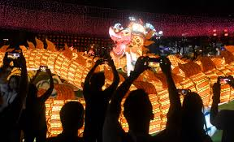
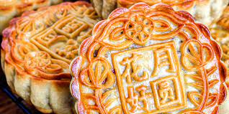
中秋节 (zhōng qiū jié) The Mid-Autumn Festival
The celebration is over 2,000 years old (perhaps more!) and is directly related to the legends before.
Given its mystical nature, the moon has been celebrated and worshipped since the start of civilization.
Families and friends gather to celebrate a god harvest and reunion.
It happens when the moon is at its fullest and roundest
15th day of the 8th month on the Lunar Calendar
One of the largest holidays in Chinese culture
Though, only made national holiday in 2006
Mooncakes
Was originally an offering to the moon, now for consumption
Many different kinds: pork, chicken, rice pudding, poppy seed…
Families reunite, and watch the moon throughout the night

Slide 7
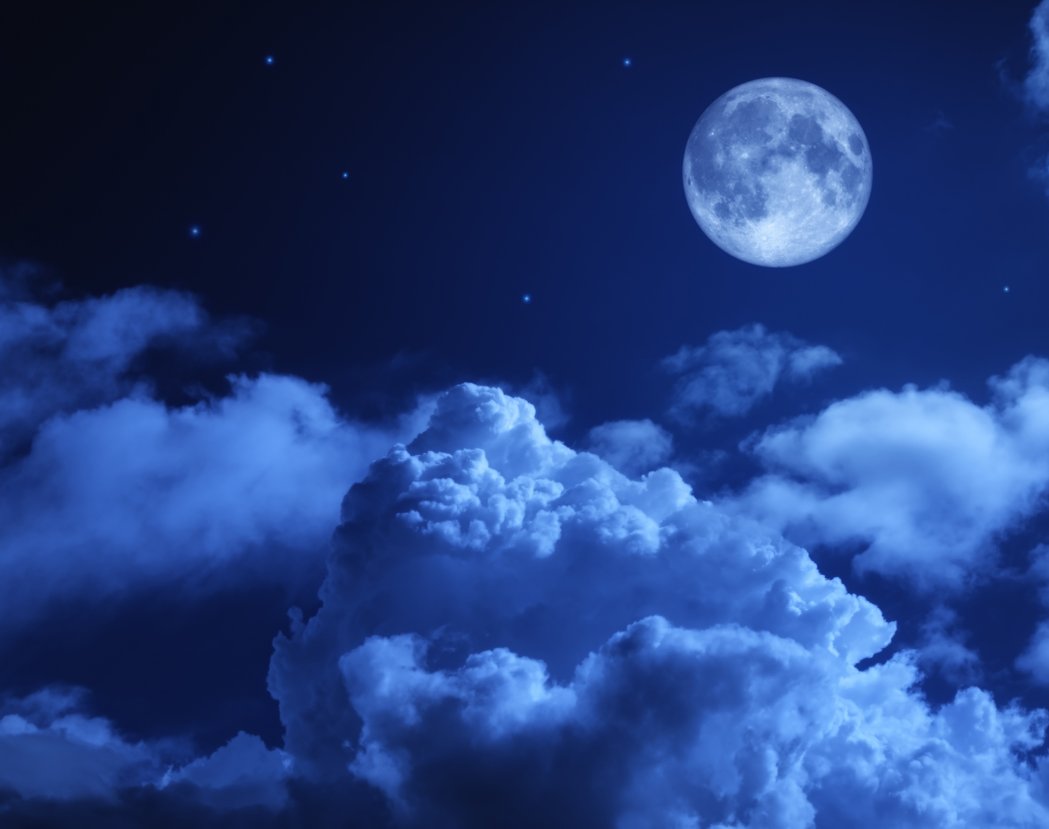
Sources
The Moon in Chinese Culture: Symbolism and Significance – Asian Journal USA
Stories behind the Moon: How Chinese people celebrate the Mid-Autumn Festival-China Story
The Facts About the Chinese Moon Festival (thoughtco.com)
The Moon in Chinese Culture: Symbolism and Significance – Asian Journal USA
Chinese calendar | Lunar Year, Solar Eclipses & Solstices | Britannica
Chinese New Year: What is it and how is it celebrated? - BBC News
All images supplied by Google

